Slide 1
Anomaly Detection
Powered by
Quantum Machine Learning &
Artificial Intelligence
Entangled Engineers

Slide 2
Team Introduction
Karan Y Islur [RA2111028010156]
Amit Modhwadia [RA2111003010656]
Tanishque Kumar [RA2111003010086]
Shriyanshi [RA2111003010565]

Slide 3
Problem Statement
Any transaction settlements are processed based on the detailed trade level data which is sourced from various systems, further transformed and standardized.
These trade feeds may have millions of records each day capturing all the trading activity and there are edge cases of inflated/missing prices, bad data, fat finger etc. which result in erroneous calculations and payments.
In order to resolve the above issue, we are going to develop an Anomaly Detection Framework that will help identify the potential issues and irregularities in the data when compared with the regular submissions.

Slide 4
Tech Stack
Python
DBMS (SQL/ NoSQL)
COBYLA, Cplex and Docplex (optimizer)
Machine Learning
Quantum Algorithms and Quantum Machine Learning
Tableau
Quantum Optimization
Quantum Homomorphic Encryption

Slide 5
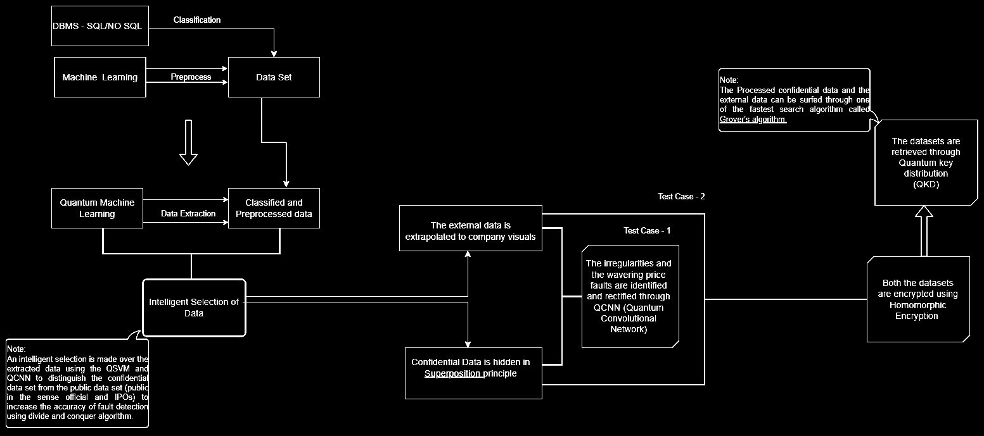
Work Flow diagram
5

Slide 6
Brief Explanation
The system commences by ingesting the dataset and leverages Database Management Tools (DBMS) such as SQL or NoSQL to implement a rigorous classification process. Classical Machine Learning algorithms are then employed for comprehensive data preprocessing. This phase meticulously structures and extracts the previously unstructured data, employing the prowess of Quantum Machine Learning techniques.
The Quantum Machine Learning (QML) model subsequently assumes the role of an intelligent selection module. It refines the structured data, differentiating between confidential and external information. The external data is then visualized adhering to stringent company regulations and restrictions. The strategic division of the database into two distinct sectors is predicated upon the objective of alleviating the strain on the model while endeavoring to engineer a fault-tolerant system for the database, ultimately striving for enhanced precision.
To safeguard the integrity of the confidential dataset and prevent unauthorized access or exfiltration, the system leverages the power of the superposition principle to shroud it in a quantum veil. This constitutes a critical layer of protection for sensitive data.

Slide 7
Brief Explanation
Both the confidential and external datasets are subsequently processed by a Quantum Convolutional Neural Network (QCNN) to meticulously detect and rectify concurrent faults, corrupt entries, and inflated or bounced transactions within the data. This empowers the system to become self-learning and fault-tolerant model whose precision is way accurate over the dynamic dataset as in the case of daily trade activity.
For an additional layer of security, both the confidential and external datasets are encrypted using the formidable capabilities of end-to-end homomorphic encryption. This technique allows authorized personnel to perform computations directly on the encrypted data, eliminating the need for decryption and significantly enhancing security. Quantum Key Distribution (QKD) serves as the retrieval mechanism for both datasets, providing system administrators with a demonstrably more secure environment.
Our model is nearly close enough to achieve Quantum Finance and Quantum Crypto Supremacy.

Slide 8
Czech Financial Transactions Dataset
The Czech bank dataset which includes relations for accounts, clients, dispositions linking clients to accounts, payment orders, transactions, loans, credit cards, and demographic data about districts. Clients can manage multiple accounts, and accounts can have multiple clients. The bank offers loans and credit cards to clients, with multiple credit cards possible per account but only one loan per account. Demographic data provides insights into district characteristics. This dataset offers a comprehensive view of the relationships within the Czech banking system.
It consists of various relations that describe the clients and their accounts. Here is a summary of the different relations:
Account: Contains static characteristics of an account such as date of creation and branch address.
Client: Describes characteristics of clients who can manage accounts.
Disposition: Relates clients with accounts, defining their rights to operate accounts.

Slide 9
Contd..
Permanent Order: Describes characteristics of payment orders.​
Transaction: Records individual transactions on an account.​
Loan: Describes loans granted for specific accounts.​
Credit Card: Details credit cards issued to an account.​
Demographic Data: Provides demographic information about districts, which can offer insights into client profiles.​
Clients and accounts are linked through the "disposition" relation, allowing multiple clients to manage a single account or one client to manage multiple accounts. The "loan" and "credit card" relations outline services offered by the bank, with multiple credit cards possible per account but only one loan per account. The "demographic data" relation offers publicly available district information like unemployment rates, aiding in understanding client demographics.
Dataset size that is to be worked upon is 179,603
8

Slide 10
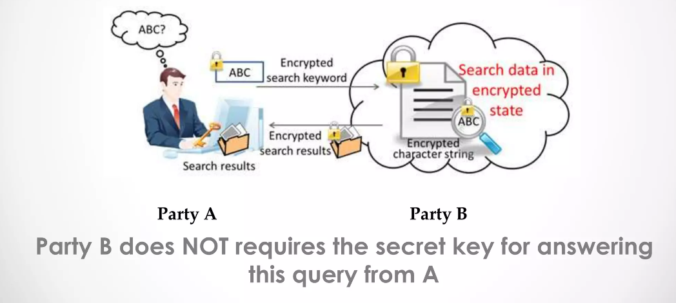
Homomorphic Encryption
A crypto-system that allows another party to perform operations on cipher text(Encrypted Text) without having knowledge of your secret key/Password.
Homomorphic (Mathematical Term) describes the transformation of one data set into another while preserving relationships between elements in both sets.
So if X1 and X2 are two numbers, E(X1) and E(X2) represents the encryption of these numbers with a secret key, another party would be able to compute E(X1 + X2) or E(X1 * X2) without knowing the secret key
9

Slide 11
Future Plans
The implementation of Quantum AI in fintech companies, particularly in relation to trading and stocks, offers a transformative potential for the financial industry. Quantum AI, which combines the power of quantum computing with advanced AI algorithms, enables faster and more accurate predictions in investment strategies. This technology allows investors to identify emerging trends, anticipate market movements, and make timely decisions based on real-time analysis, providing a competitive advantage in the dynamic world of finance
Quantum AI facilitates portfolio management by enhancing diversification strategies, maximizing returns, and optimizing investment decisions through advanced predictive analysis. By leveraging the computational power of quantum computing and AI algorithms, financial institutions can streamline trading strategies, identify market trends efficiently, and make data-driven decisions in real-time
Overall, the implementation of Quantum AI in fintech companies for trading and stocks signifies a significant advancement in the financial industry. It offers faster data processing, improved risk management, enhanced security measures, optimized trading strategies, and advanced financial predictions.

Slide 12
Thank you!

